Slide 1
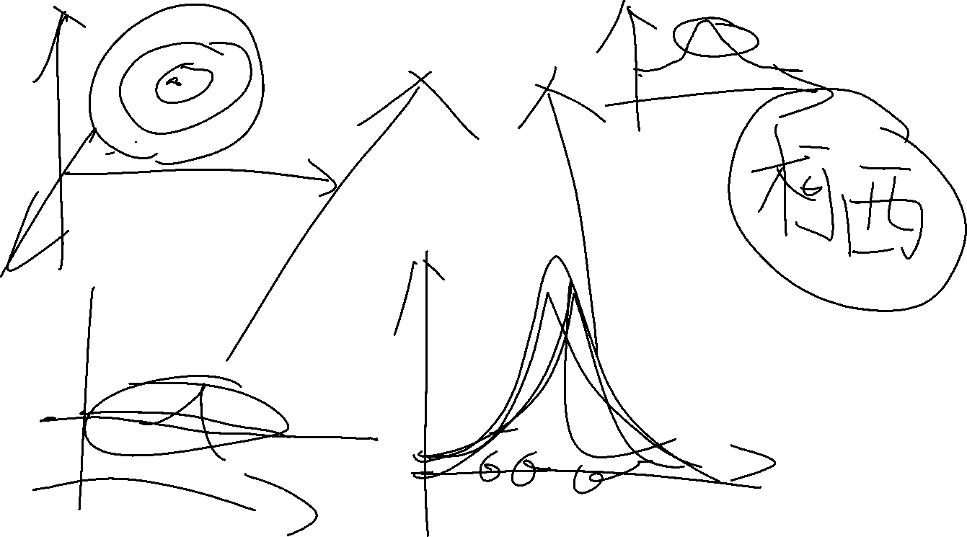
The Bayes and the Bayesian Brain
Xiaokai Xia
2018.5.21

Slide 2
The family tree of Neuroscience
Neurotree

Slide 3
Neurotree
The Neuroscience Academic Family Tree
Entirely crowd-sourced

Slide 4
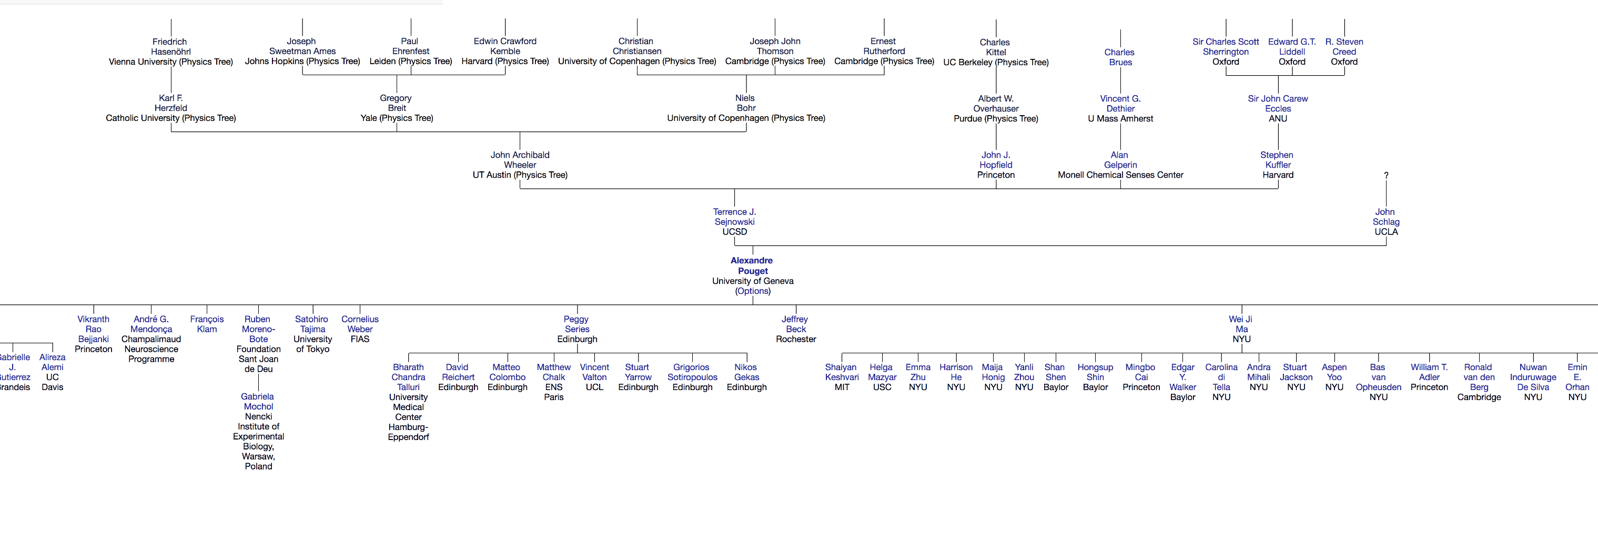
The family tree of Pouget

Slide 5

Alexandre Pouget
Field: Computational Neuroscience
Purpose: General principles of representation and computation in neural circuits
Current work:
The neural basis of probabilistic inference
Neurons represent knowledge in the form of probability distributions
Neurons acquire new knowledge by following the rules of probabilistic inference
Evidence:
Powerful and optimal computational principle
Wide used in many field

Slide 6
Peggy Series
Computational Psychiatry
Use the framework of reinforcement learning models and Bayesian inference
Understand the factors behind individual variability and clinical disorders
Expectations and the Bayesian Brain
Perception is modulated by our expectations and prior beliefs
The factors which can mediate the expectations

Slide 7
Others
Sophie Deneve
Anthony D Wagner
Han Hou
……

Slide 8
The calculation of Bayesian
Using pdf as number

Slide 9

The components of Bayesian formula
$p\left(H\right)= \frac{p\left(D | H\right)}{p\left(D\right)}p(H)$
Components
Prior: p(H)
Likelihood: p(D|H)
Posterior: p(H|D)
Evidence: p(D)

Slide 10

The components of Bayesian formula
$p\left(H\right)= \frac{p\left(D | H\right)}{p\left(D\right)}p(H)$
Components
Prior: p(H)
Likelihood: p(D|H)
Posterior: p(H|D)
Evidence: p(D)

Slide 11
The meaning of those components
Prior
The knowledge of parameters we know before we observe the data
Likelihood
The reliability of a set of observed data under a specific parameter
Posterior
All of the knowledge we know under the observed data and conditions
Evidence
The mean of the probability of specific observed data among all possible parameters

Slide 12
The philosophy of Bayesian brain
All of components
subject to an probability density distribution
We know the world by
estimate the parameters of the probability density distribution
in the Bayesian formula
Research goal
Estimate the parameters
Estimate the posterior distribution

Slide 13
The inference method in Bayes
Non-MCMC
Grid estimate
Quadratic approximation
Variational methods
MCMC
Metropolis-Hastings
Hamiltonian Monte Carlo

Slide 14
The inference method in Bayes
Non-MCMC
Grid estimate
Quadratic approximation
Variational methods
MCMC
Metropolis-Hastings
Hamiltonian Monte Carlo

Slide 15
Grid estimate
Conforming the section of parameters
Dividing this section to some grid points
Calculate the likelihood and the posterior in any point

Slide 16
Code – tossing a coin
# define a grid
grid = np.linspace(0, 1, grid_points)
# define prior
prior = np.repeat(5, grid_points) # uniform
#prior = (grid <= 0.4).astype(int) # truncated
#prior = abs(grid - 0.5) # "M" prior
# compute likelihood at each point in the grid
likelihood = stats.binom.pmf(heads, tosses, grid)

Slide 17
Code – tossing a coin
# compute product of likelihood and prior
unstd_posterior = likelihood * prior
# standardize the posterior, so it sums to 1
posterior = unstd_posterior / unstd_posterior.sum()
return grid, posterior

Slide 18
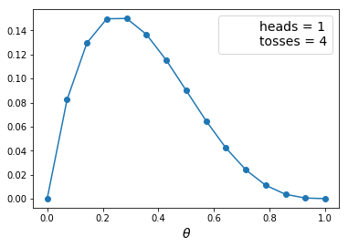
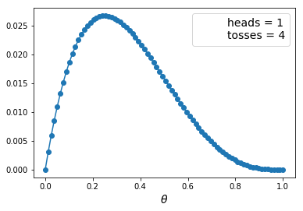
Result
Points = 15
Points = 100

Slide 19
Quadratic approximation

Slide 20
Quadratic approximation

Slide 21
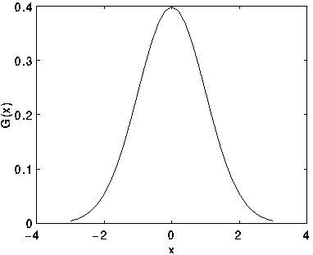
Quadratic approximation

Slide 22
Quadratic approximation
Find the hill
Estimate the curvature around the hill
Curve the Gaussian curve

Slide 23
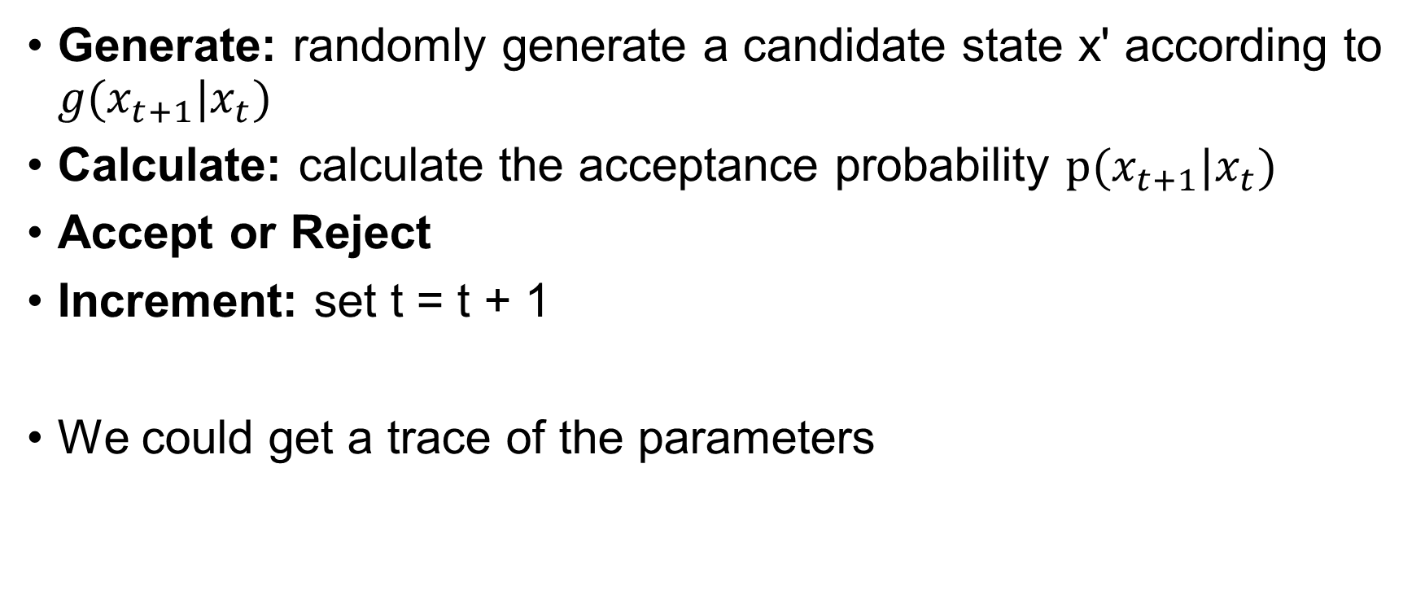
MCMC – Metropolis-Hasting
Generate: randomly generate a candidate state x' according to $g(x_{t+1}|x_{t})$
Calculate: calculate the acceptance probability $p(x_{t+1}|x_{t})$
Accept or Reject
Increment: set t = t + 1
We could get a trace of the parameters

Slide 24
Probabilistic Graphical Model
The tool to analysis Bayesian model

Slide 25
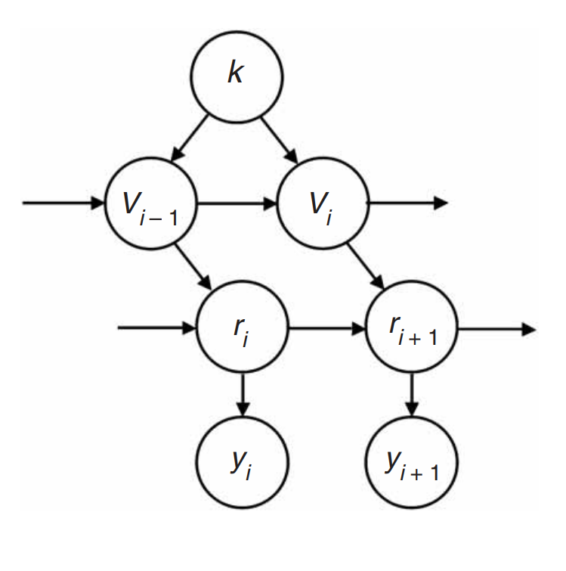
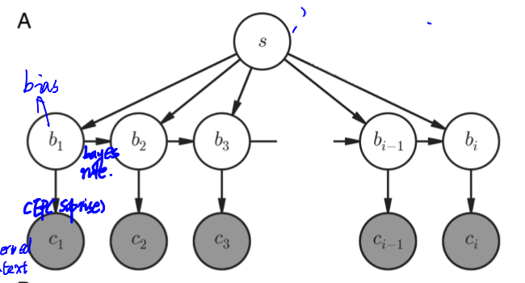
The PGM in papers
Tim Behrans et al. 2007
Waskom et al. 2016

Slide 26
A brief introduction of PGM
A framework to analysis the dependency of variables
Two element: Node & Edge
Two types
Bayesian Network (Directed Acyclic Graph)
Markov Random Field (Undirected Graph)
Bayesian Network
Each node subjects to a pdf
Can multiply each node and get the joint distribution
In the future
Structure learning

Slide 27
The usage of PGM
Inference the latent variable
Inference the formula in our model

Slide 28
The usage of PGM
Inference the latent variable
Inference the formula in our model

Slide 29
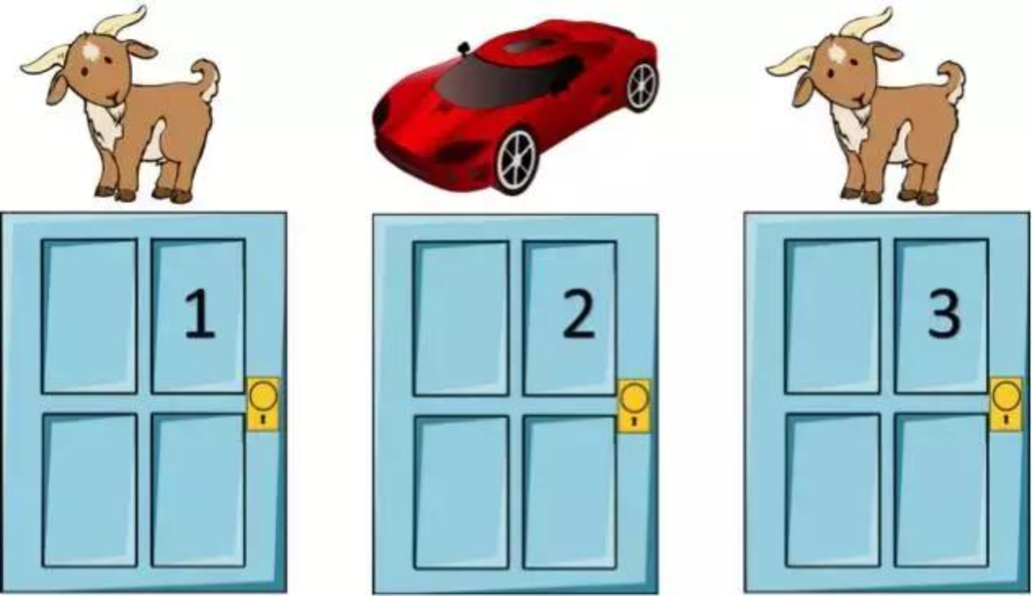
Inference the formula in our model
An example from Monty Hall problem

Slide 30
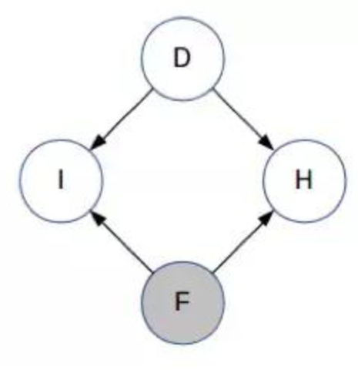
Inference the formula of our model
D : The door with the car
F : Your first choice
H : The door which the host opened
I : Whether F is D

Slide 31
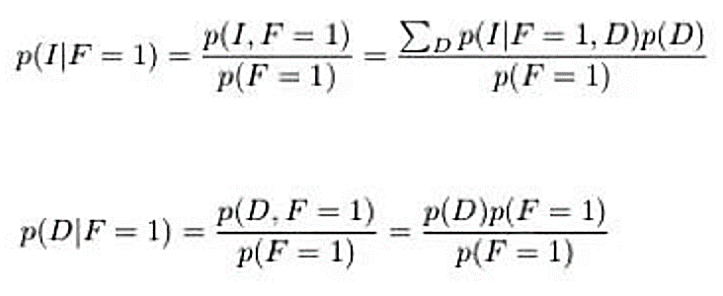
Inference the formula of our model
When we just open the first door

Slide 32
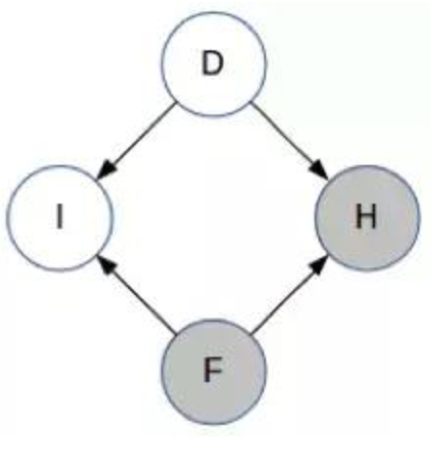
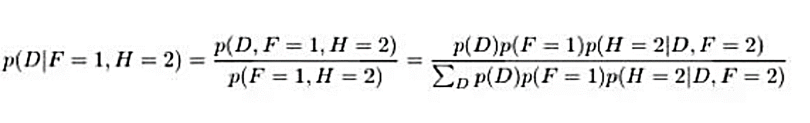
Inference the formula of our model
When the host open a door

Slide 33
The Bayesian brain
the role of uncertainty in neural coding and computation

Slide 34
Abstract
Background
Environment information is uncertainty
The brain using uncertainty information for perception and action
Conception
Bayes' optimal
Bayesian coding hypothesis
Goal
To prove that the mechanism of brain is Bayesian code

Slide 35
Introduction
Many factors contribute to limiting the reliability of information
E.g. 2D to 3D
Human brain must deal with those uncertainty to generate perceptual representation
The mechanism is optimal Bayesian observers
Optimal Bayesian observers is based on neuroscience, along with the behavioral or computational work

Slide 36
The philosophy under Bayesian method
We know the world by
estimate the parameters of the probability density distribution
in the Bayesian formula
All of components
subject to an probability density distribution
Bayesian method
Deal with a set of sensory information by pdf
Deal with unknown variable by conditional probability density
Deal with data efficiently over space and time

Slide 37
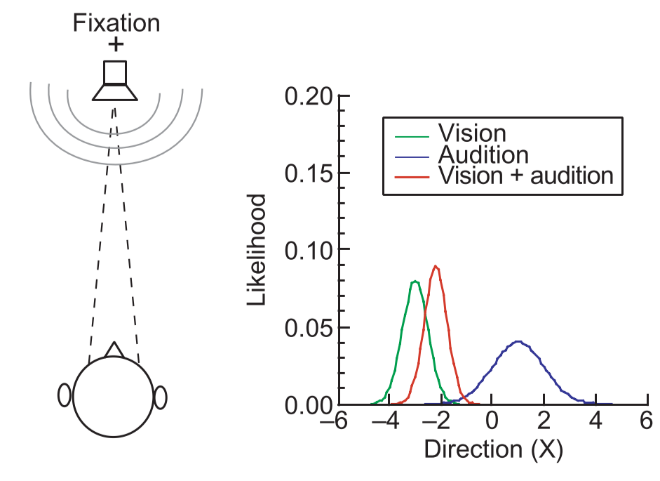
Integrating multiple sensory cues

Slide 38
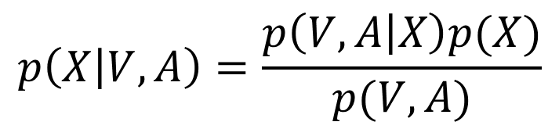
Integrating multiple sensory cues
$$p\left(X | V,A\right)=\frac{p\left(V,A | X\right)p(X)}{p(V,A)}$$

Slide 39
The performing level of information
Cannot achieve the level of performance in physical stimulus
The efficiencies for performance across task is low
The Bayesian coding hypothesis is in neural

Slide 40
Neural representations of uncertainty
Binary variables
Convolution Code
Gain Encoding

Slide 41
Binary variables
Represent the direction of motion
Two populations of neurons respond to different directions
One populations of neurons respond to both directions
Using single-cell recordings prove both schemes

Slide 42
How to represent any value around a circle

Slide 43
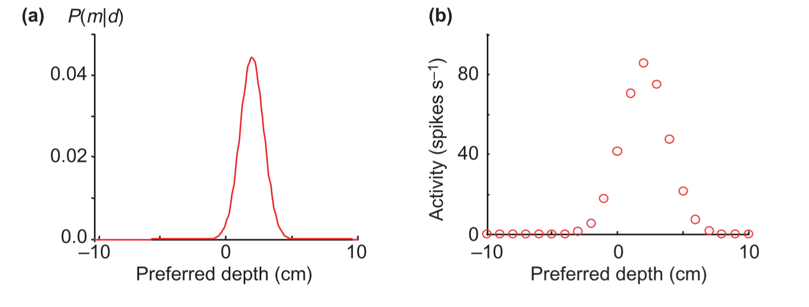
Convolution codes

Slide 44
Convolution codes
Sampling the probability density function by a filter
Each neuron simply computes a dot in the curve
The population pattern of activity looks like the original pdf

Slide 45
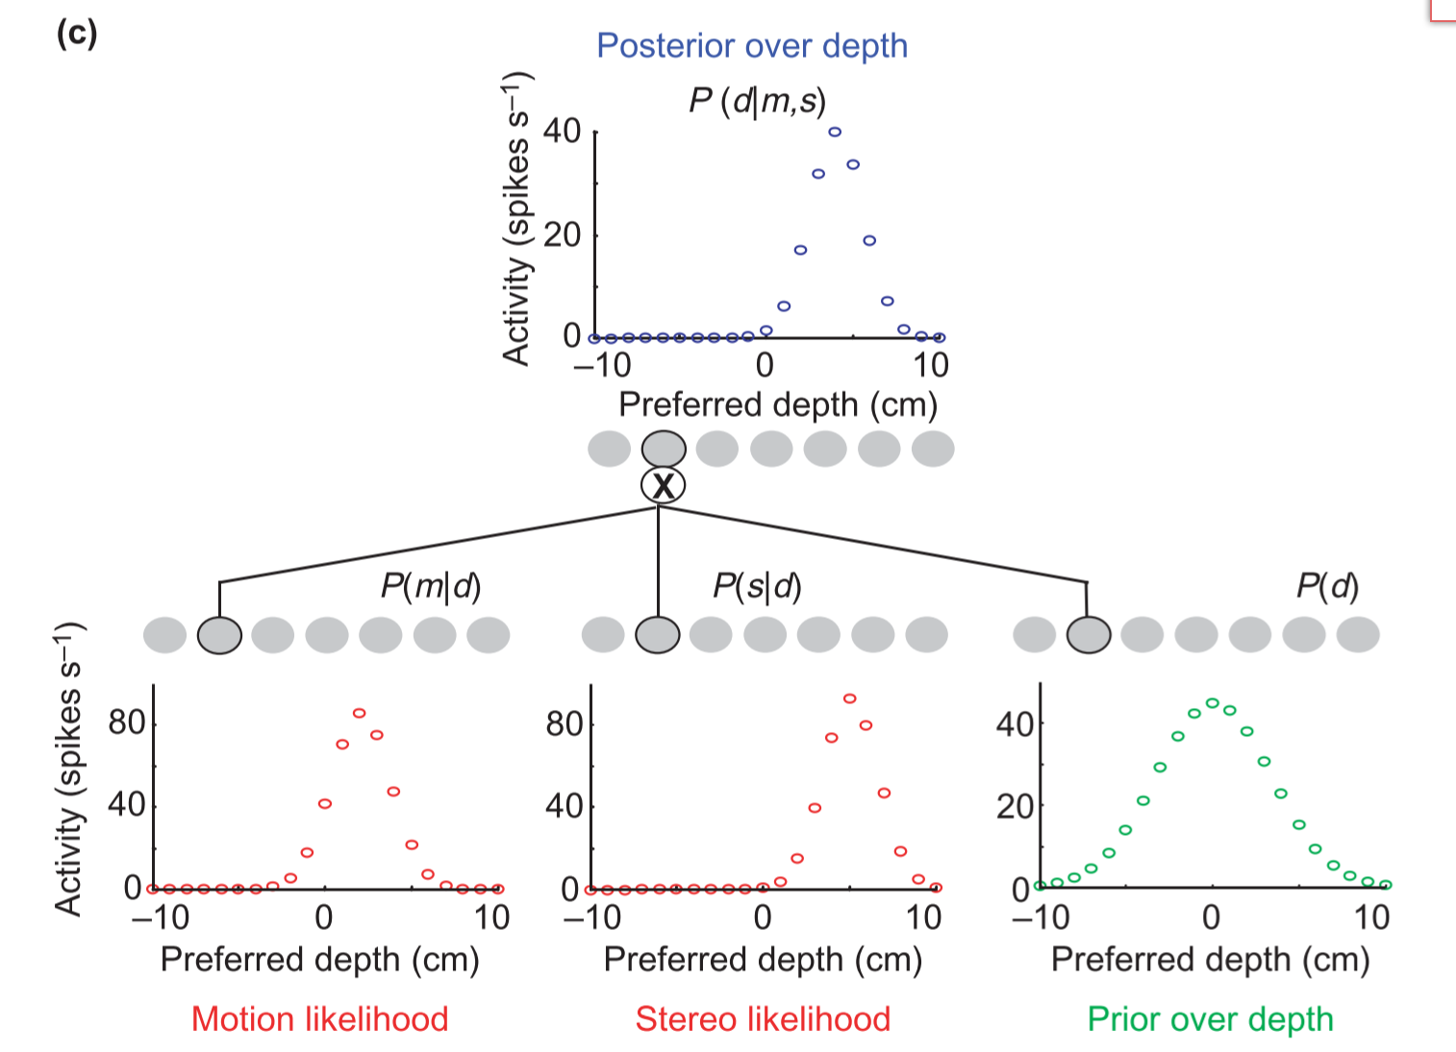
Convolution codes
Further, neuros can integrate multiple information from different sensory

Slide 46
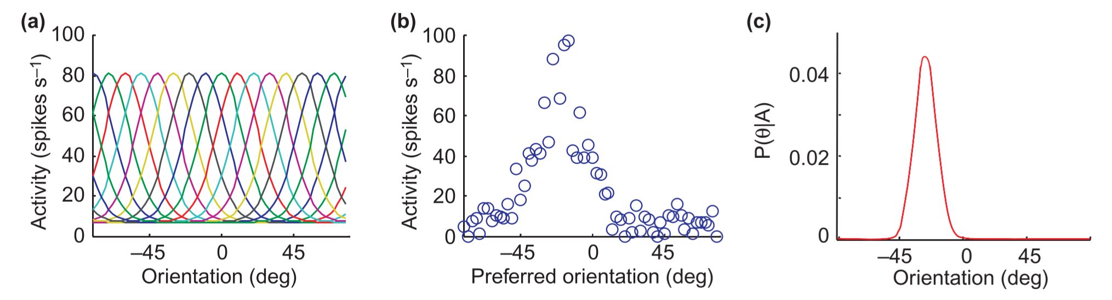
Gain encoding

Slide 47
The neuroscience evidence
Those research give the evidence that the brain process information by Bayesian method

Slide 48
Abstract
Background
Environment information is uncertainty
The brain using uncertainty information for perception and action
Conception
Bayes' optimal
Bayesian coding hypothesis
Goal
To prove that the mechanism of brain is Bayesian code

Slide 49
Introduction
Many factors contribute to limiting the reliability of information
E.g. 2D to 3D
Human brain must deal with those uncertainty to generate perceptual representation
The mechanism is optimal Bayesian observers
Optimal Bayesian observers is based on neuroscience, along with the behavioral or computational work

Slide 50
The philosophy under Bayesian method
We know the world by
estimate the parameters of the probability density distribution
in the Bayesian formula
All of components
subject to an probability density distribution
Bayesian method
Deal with a set of sensory information by pdf
Deal with unknown variable by conditional probability density
Deal with data efficiently over space and time

Slide 51
Integrating multiple sensory cues

Slide 52
Integrating multiple sensory cues
$$p\left(X | V,A\right)=\frac{p\left(V,A | X\right)p(X)}{p(V,A)}$$

Slide 53
The performing level of information
Cannot achieve the level of performance in physical stimulus
The efficiencies for performance across task is low
The Bayesian coding hypothesis is in neural

Slide 54
Neural representations of uncertainty
Binary variables
Convolution Code
Gain Encoding

Slide 55
Binary variables
Represent the direction of motion
Two populations of neurons respond to different directions
One populations of neurons respond to both directions
Using single-cell recordings prove both schemes

Slide 56
How to represent any value around a circle

Slide 57
Convolution codes

Slide 58
Convolution codes
Sampling the probability density function by a filter
Each neuron simply computes a dot in the curve
The population pattern of activity looks like the original pdf

Slide 59
Convolution codes
Further, neuros can integrate multiple information from different sensory

Slide 60
Gain encoding

Slide 61
The neuroscience evidence
Those research give the evidence that the brain process information by Bayesian method

Slide 62
Abstract
Background
Environment information is uncertainty
The brain using uncertainty information for perception and action
Conception
Bayes' optimal
Bayesian coding hypothesis
Goal
To prove that the mechanism of brain is Bayesian code

Slide 63
Introduction
Many factors contribute to limiting the reliability of information
E.g. 2D to 3D
Human brain must deal with those uncertainty to generate perceptual representation
The mechanism is optimal Bayesian observers
Optimal Bayesian observers is based on neuroscience, along with the behavioral or computational work

Slide 64
The philosophy under Bayesian method
We know the world by
estimate the parameters of the probability density distribution
in the Bayesian formula
All of components
subject to an probability density distribution
Bayesian method
Deal with a set of sensory information by pdf
Deal with unknown variable by conditional probability density
Deal with data efficiently over space and time

Slide 65
Integrating multiple sensory cues

Slide 66
Integrating multiple sensory cues
$$p\left(X | V,A\right)=\frac{p\left(V,A | X\right)p(X)}{p(V,A)}$$

Slide 67
The performing level of information
Cannot achieve the level of performance in physical stimulus
The efficiencies for performance across task is low
The Bayesian coding hypothesis is in neural

Slide 68
Neural representations of uncertainty
Binary variables
Convolution Code
Gain Encoding

Slide 69
Binary variables
Represent the direction of motion
Two populations of neurons respond to different directions
One populations of neurons respond to both directions
Using single-cell recordings prove both schemes

Slide 70
How to represent any value around a circle

Slide 71
Convolution codes

Slide 72
Convolution codes
Sampling the probability density function by a filter
Each neuron simply computes a dot in the curve
The population pattern of activity looks like the original pdf

Slide 73
Convolution codes
Further, neuros can integrate multiple information from different sensory

Slide 74
Gain encoding

Slide 75
The neuroscience evidence
Those research give the evidence that the brain process information by Bayesian method

Slide 76
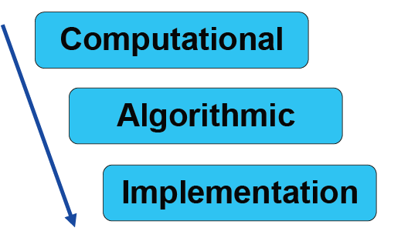
Marr's Levels of Analysis

Slide 77
Conclusion
The Bayesian philosophy inspire the theory of Bayesian brain
Single-cell recordings show the evidence that we process information by Bayes

